Slide 1
SECURE DATA HIDING in images using steganography
CAPSTONE PROJECT
Presented By:
Student Name : Gowtham M
College Name & Department : Agni college of Technology & ECE

Slide 2
OUTLINE
Problem Statement
Technology used
Wow factor
End users
Result
Conclusion
Git-hub Link
Future scope

Slide 3
Problem Statement
The challenge is to securely conceal a secret message within a digital image without significantly altering its visual appearance, ensuring it remains undetectable to the naked eye.
Existing methods often lack robust encryption or are prone to visible changes, limiting their practicality for secure communication.
This project aims to address this by embedding messages into pixel values using Python and OpenCV, but current implementation may result in noticeable image distortions.
The goal is to develop an efficient steganography solution with improved concealment (e.g., LSB techniques) and secure passcode-based decryption for practical use.

Slide 4
Technology used
Libraries
Python: The core programming language used to write and execute the steganography script, providing a versatile environment for development.
OpenCV (cv2): A computer vision library essential for loading, processing, and saving images, allowing pixel-level modifications for embedding and extracting messages.
os Module: A built-in Python module used for interacting with the operating system, such as opening the encrypted image file on Windows.
Platforms
Windows: The operating system targeted in the script, where os.system("start ...") is used to open the encrypted image file, though the code can be adapted for macOS or Linux with minor changes.
Python Environment: Any platform supporting Python 3.x (e.g., Windows, macOS, Linux) can run the script, provided the required libraries are installed.

Slide 5
Wow factors
Simple yet Powerful Encryption: The project uses a straightforward approach to hide secret messages within image pixels using ASCII values, making it accessible for beginners while still demonstrating core steganography concepts.
Interactive Passcode Security: It incorporates a passcode-based decryption system, adding a layer of intrigue and security that engages users and simulates real-world secure communication.
Visual Impact Demonstration: The project visually showcases how data embedding can alter an image, offering a tangible learning experience about the trade-offs between concealment and visibility—perfect for educational purposes.
Customizable and Expandable: Built with Python and OpenCV, it’s highly customizable, allowing users to enhance it with advanced techniques like LSB steganography or encryption, making it a springboard for innovation.
Real-Time Engagement: Users can instantly encode, save, and decrypt messages with their own images, creating an interactive and hands-on experience that feels both fun and practical.

Slide 6
End users
Students and Educators: Those learning or teaching computer science, cryptography, or image processing can use this project as an educational tool to understand steganography, Python programming, and OpenCV.
Hobbyists and Tech Enthusiasts: Individuals interested in coding, cybersecurity, or digital art may explore this project for fun, to experiment with hiding messages, or to build on its functionality.
Developers and Researchers: Programmers or researchers working on image processing, data hiding, or secure communication can use or modify this project as a starting point for more advanced steganography applications.
Security Professionals: Those interested in basic data protection or covert communication might find this useful for demonstrating or testing simple steganographic techniques, though it’s not suited for production-level security.
Creative Professionals: Artists or designers curious about blending technology with visuals might use it to create unique, hidden-message artworks or interactive media projects.

Slide 7
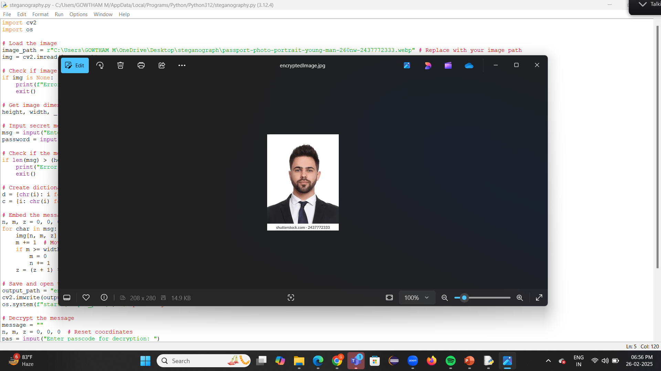
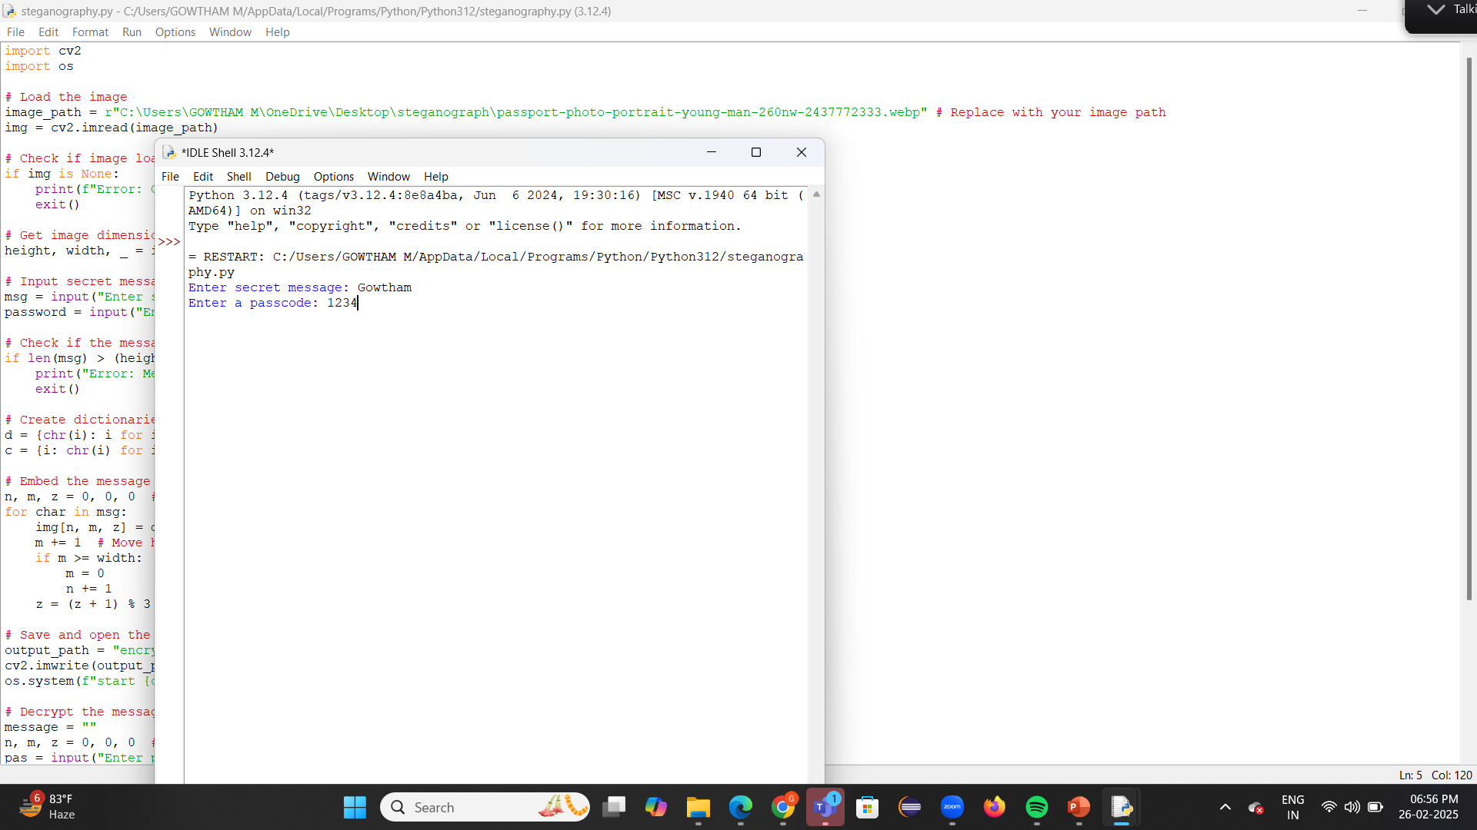
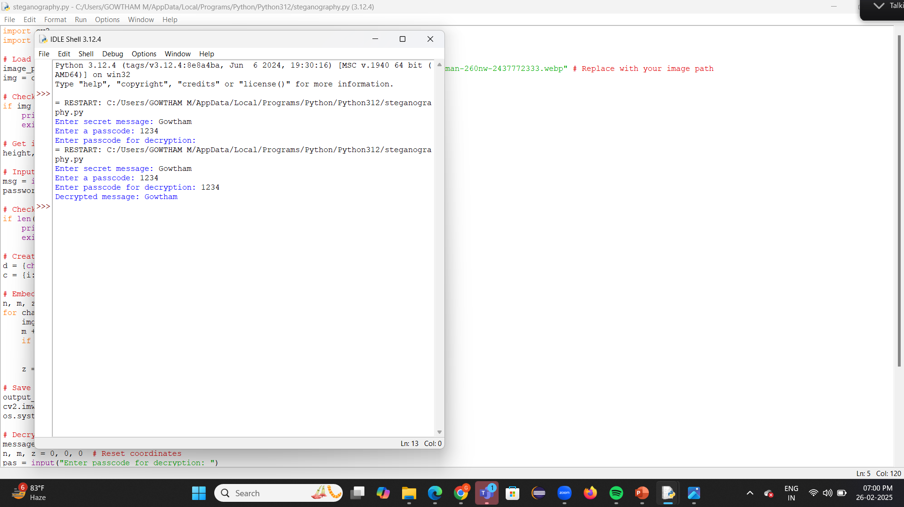
Results

Slide 8
Conclusion
Addresses Core Challenge: The project successfully tackles the problem of securely hiding a secret message within a digital image by embedding ASCII values into pixel data using Python and OpenCV, fulfilling the goal of demonstrating steganography.
Demonstrates Functionality: It effectively implements passcode-based encryption and decryption, providing a basic solution for secure message concealment as outlined in the problem statement.
Identifies Limitations: The current method reveals visible changes in the image due to direct pixel value replacement, aligning with the problem’s concern about maintaining visual imperceptibility and highlighting areas for improvement.
Educational Value: Serves as a strong foundation for learning and experimentation, offering insights into steganography and image processing, which supports the problem’s aim of creating a practical educational tool.
Future Enhancement Potential: Suggests advancements like LSB steganography to enhance concealment and security, directly addressing the problem of developing a more undetectable and practical steganography solution for real-world use.

Slide 9
GitHub Link
Make sure that there should be readme file
https://github.com/Gowtham280103/IBM_project_Steganography.git

Slide 10
Future scope(optional)
Advanced Steganography Techniques: Implement more sophisticated methods like Least Significant Bit (LSB) steganography or spread-spectrum techniques to hide messages with minimal visual impact, enhancing the project’s ability to maintain image quality while ensuring secure data concealment.
Improved Security Measures: Integrate cryptographic algorithms (e.g., AES encryption) for the message before embedding, and use multi-factor authentication or complex passcodes to strengthen security, making the system more robust for real-world applications.
Support for Multiple Formats: Expand the project to handle various image formats (e.g., PNG, GIF) and potentially video or audio files, broadening its applicability for multimedia steganography and increasing its versatility.
Real-Time Applications: Develop a user-friendly interface (e.g., a desktop or web application) for real-time encoding and decoding, enabling practical use in fields like secure communication, digital watermarking, or covert operations.
Machine Learning Integration: Utilize machine learning models to optimize hiding patterns, detect tampering, or improve resistance to steganalysis (techniques to detect hidden data), pushing the project toward cutting-edge research and commercial applications.
Scalability and Performance: Enhance the algorithm’s efficiency to handle larger images and messages, and optimize for performance on different platforms (e.g., mobile devices, cloud systems), making it more accessible and scalable for diverse users.
Integration with IoT and Blockchain: Explore embedding messages in IoT device images or using blockchain for secure, tamper-proof storage of steganographic data, opening new avenues in smart systems and decentralized security.

Slide 11
THANK YOU

